Slide 1
Why EDA ?
detection of mistakes
checking of assumptions
preliminary selection of appropriate models
determining relationships among the dependent variable and independent variable

Slide 2
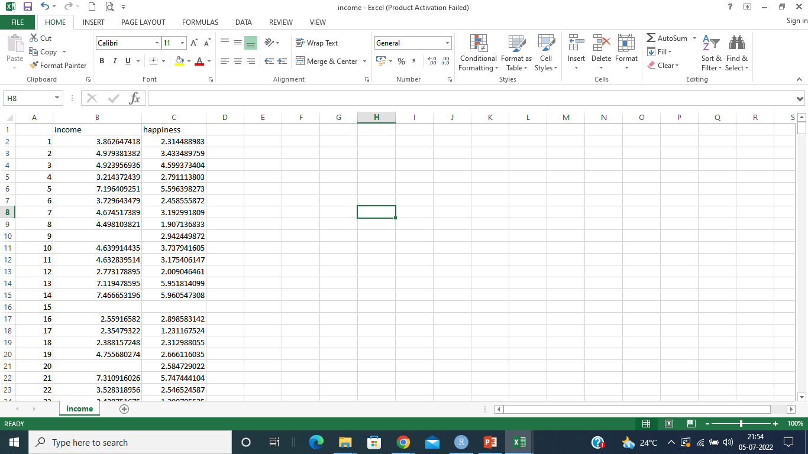
Explanatory variable
subject identifier
Outcome Variable
one row per experimental subject

Slide 3
Why EDA ?
detection of mistakes
checking of assumptions
preliminary selection of appropriate models
determining relationships among the explanatory variables, and
assessing the of relationships between explanatory and outcome variables.

Slide 5
Types of EDA(Exploratory Data Analytics)
EDA
Graphical
Non-Graphical
Univariate
Graphical
Multivariate
Graphical
Univariate
Non-Graphical
Multivariate
Non-Graphical

Slide 6
Univariate Analysis
The purpose of univariate analysis is to understand the distribution of values for a single variable.

Slide 7
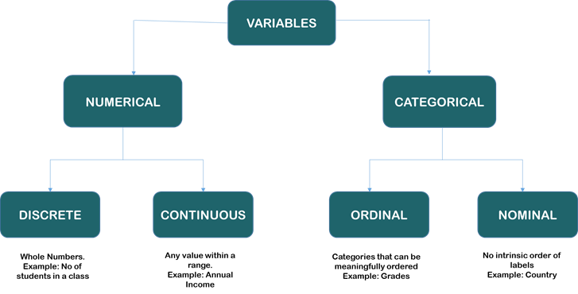
Attribute types

Slide 8
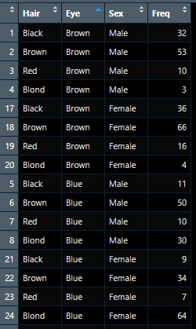
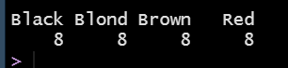
Univariate non-graphical EDA for categorical data
A simple tabulation of the frequency of each category is the best univariate non-graphical EDA for categorical data.
Ex. Frequency distribution table can be created for the analysis of Hair attribute in the given data set
# R code to create a frequency distribution table for attribute “Hair”
df <-read_csv("HairEyeColor.csv")
fre<-table(df$Hair)
fre
#output

Slide 9
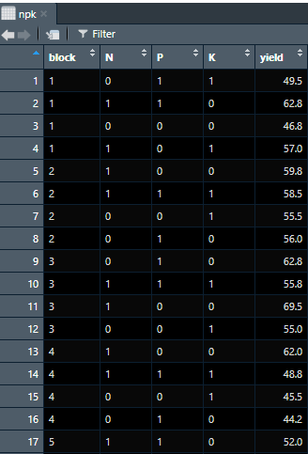
Univariate non-graphical EDA for quantitative data
Univariate EDA for a quantitative/numerical variable is a way to make preliminary assessments about the population distribution of the variable using the data of the observed sample.
The characteristics of the population distribution of a quantitative variable are its center, spread etc .

Slide 10
Measures of central tenancy
Mean
Centre of data set, can be obtained using a built in aggregation function avg in SQL
can be computed using some algebraic function on one or more distributive measures mean() = sum() /count()
It is a distributive measure – can be computed parallely on partitions
It is extremely sensitive – Even a small amount of extreme values can corrupt the mean
Trimmed mean can be obtained by chopping extreme values
It is ideal for symmetric data

Slide 11
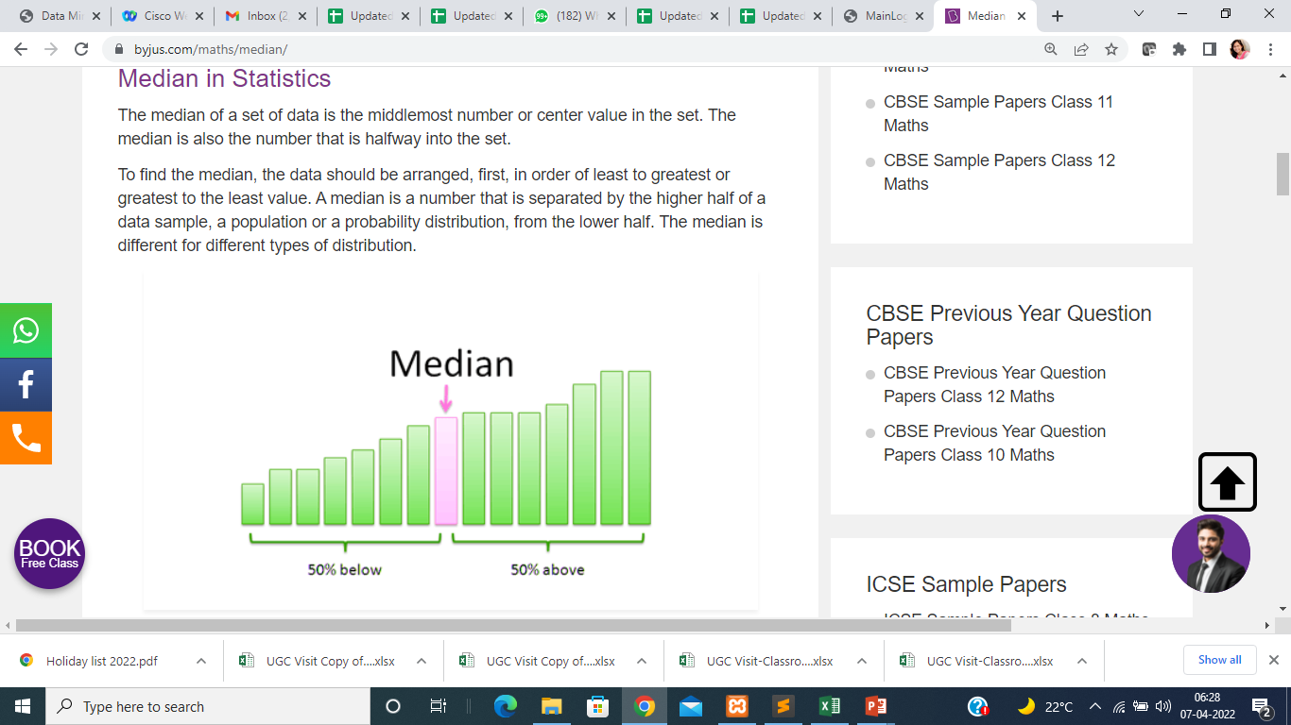
Median
Center of data set, It is the middle value of the ordered set(if n is odd) or average of two middle values(if n is even)
It need to be computed on the entire data set as a whole
It is not a distributive measure- It cannot be computed by partitioning the data and parallely computing on each partition
It is computationally expensive – sorting entire data
It is less sensitive to extreme values
Ex. (Even number of values ) : The median of 3, 3, 5, 9, 11 is 5. If there is an even number of observations, then there is no single middle value; the median is then usually defined to be the mean of the two middle values: so the median of 3, 5, 7, 9 is (5+7)/2 = 6.

Slide 12
Mode
The mode is the value that appears most frequently in a data set.
Ex. 3, 3, 6, 9, 16, 16, 16, 27, 27, 37, 48
Mode for above data is 16
We can have more than one mode in data. Ex. 3, 3, 3, 9, 16, 16, 16, 27, 37, 48
Data sets can be unimodal, bimodal , trimodal etc, Multimodal data sets have two or more modes
The mode is not affected by extreme values.

Slide 13
Measures of Dispersion/Spread
Several statistics are commonly used as a measure of the spread of a distribution, including range, interquartile range, variance, standard deviation.

Slide 14
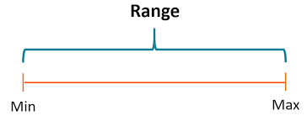
Range
Let x1,x2,...,xN be a set of observations for some numeric attribute, X. The range of the set is the difference between the largest (max()) and smallest (min()) values
Example 1: Find the range of given observations: 32, 41, 28, 54, 35, 26, 23, 33, 38, 40.
Solution: Sort data in ascending order
23, 26, 28, 32, 33, 35, 38, 40, 41, 54
Since, 23 is the lowest value and 54 is the highest value, therefore, the range of the observations will be;
Range (X) = Max (X) – Min (X)
= 54 – 23
= 31

Slide 15
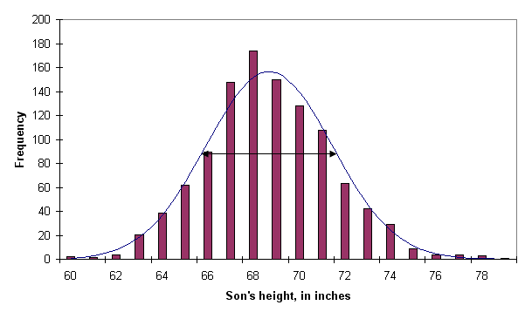
Interquartile Range
Quantile
Quantiles are cut points taken at regular intervals of a data distribution, dividing it into essentially equal size consecutive sets.
The K^{th} q-quantile for a given data distribution is the value x such that at most k/q of the data values are less than x and at most (q − k)/q of the data values are more than x, where k is an integer such that
0 < k < q. There are q − 1 quantiles
Quan1
Quan2
Quan3
Quan4

Slide 16
Quantiles
Example
Thus the 1st quantile, 64 is the value of X such that 1/5 of the observations are less than the value of 64 and 5-1/5 of the observations are greater
The 2-quantile is the data point dividing the lower and upper halves of the data distribution.
The 4-quantiles are the three data points that split the data distribution into four equal parts; each part represents one-fourth of the data distribution. They are more commonly referred to as quartiles.
Quan1
Quan2
Quan 3
Quan 4

Slide 17
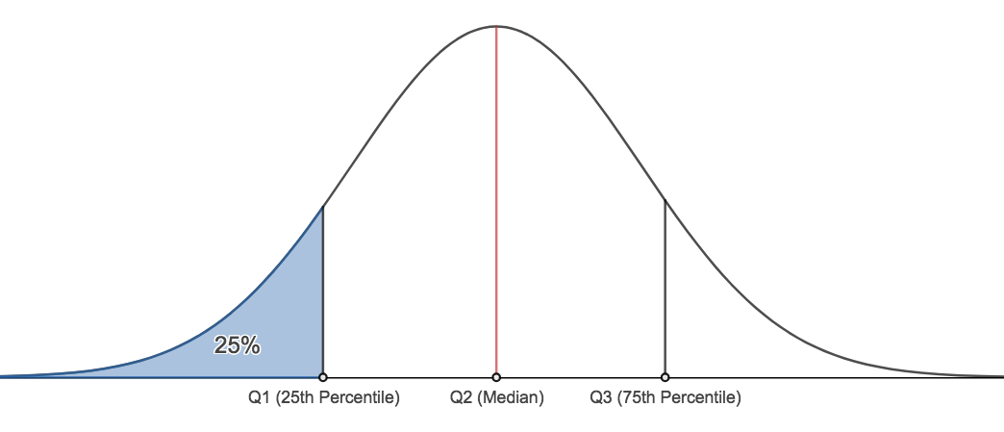
Percentile
The kth percentile of a data set is the value x with property that k percent values are below x. Median is 50th percentile.
A plot of the data distribution for some attribute X. The quantiles plotted are quartiles. The three quartiles divide the distribution into four equal-size consecutive subsets. The second quartile corresponds to the median.

Slide 18
Percentile
The kth percentile of a data set is the value x with property that k percent values are below x. Median is 50th percentile.
A plot of the data distribution for some attribute X. The quantiles plotted are quartiles. The three quartiles divide the distribution into four equal-size consecutive subsets. The second quartile corresponds to the median.

Slide 19
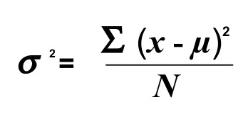
Variance and standard deviation
The variance is a standard measure of spread.
The variance of a population is defined as the mean squared deviation
Ex. n observations of a particular measurement labeled x1 through xn, Then for any data value xi , the corresponding deviation is (xi − x)
The standard deviation is simply the square root of the variance.

Slide 20
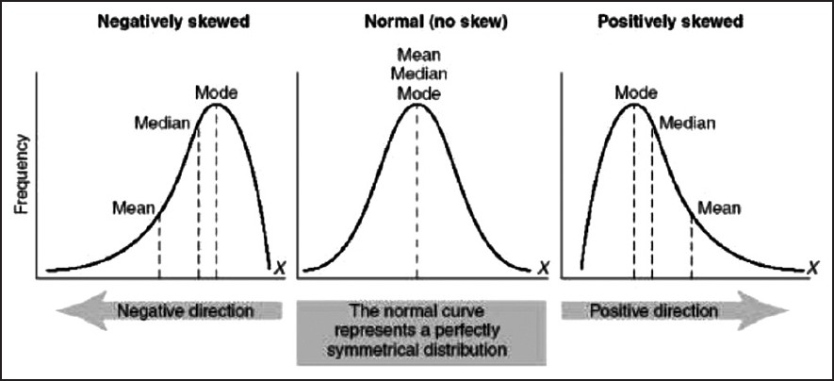
Frequency distribution curve
How to measure skewness of data ?
How to measure peaked-ness relative to Gaussian shape /normal distribution

Slide 21
Skewness and kurtosis
Skewness is a measure of asymmetry.
Kurtosis is a measure of “peaked-ness” relative to a Gaussian shape.
If the sample skewness and kurtosis are calculated along with their standard errors, we can roughly make conclusions according to the following table where e is an estimate of skewness and u is an estimate of kurtosis, and SE(e) and SE(u) are the corresponding standard errors.

Slide 22
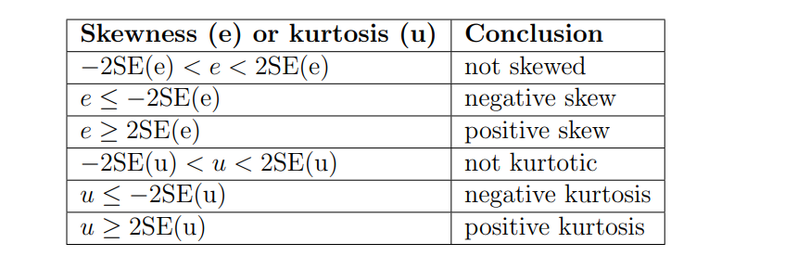

Slide 23
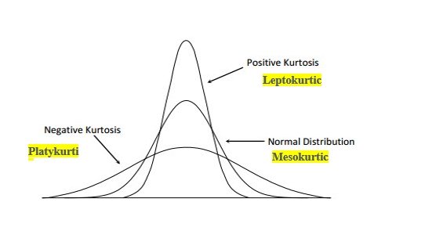
Kurtosis
C

Slide 24
Skewness

Slide 25
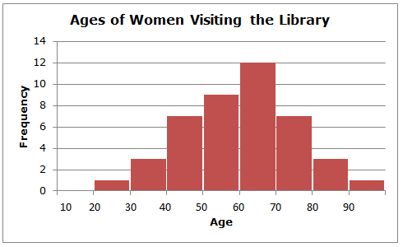
Univariate graphical EDA
Histograms
If X is numeric, the term histogram is preferred.
The range of values for X is partitioned into disjoint consecutive subranges(buckets/bins)
The range of a bucket is known as the width.
For each subrange, a bar is drawn with a height that represents the total count of items observed within the subrange.

Slide 26
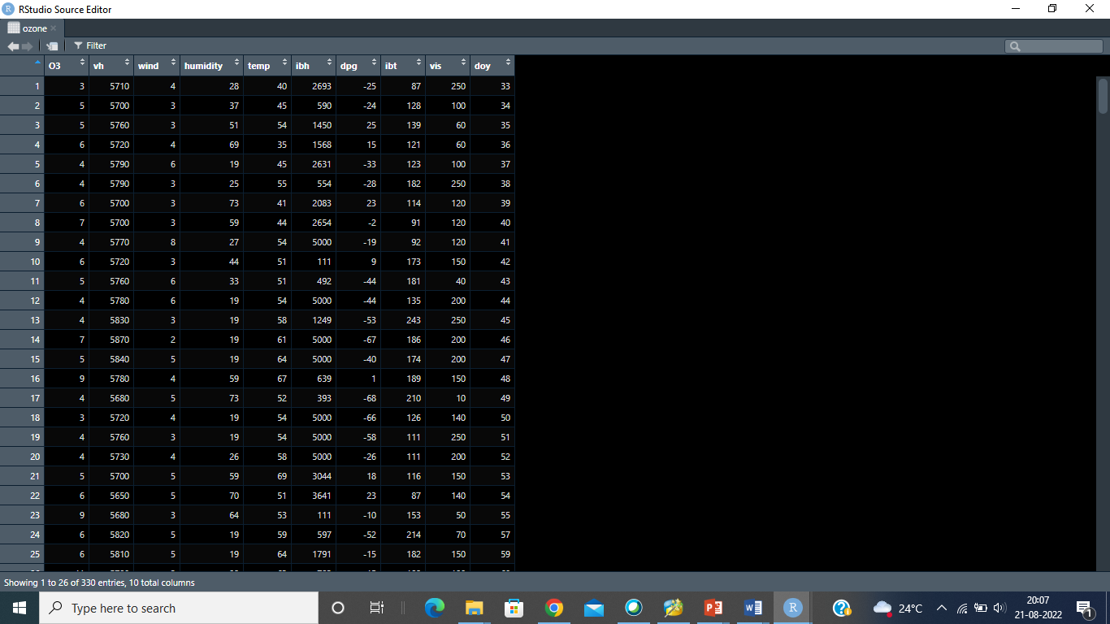
Univariate graphical EDA for numerical data (Histogram)
A data frame with 330 observations on the following 10 variables.
O3 Ozone conc., ppm, at Sandbug AFB.
vh a numeric vector
wind wind speed
humidity a numeric vector
temp temperature
ibh inversion base height
dpg Daggett pressure gradient
ibt a numeric vector
vis visibility
doy day of the year

Slide 27
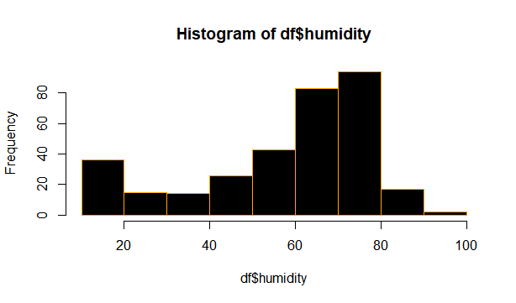
Histogram plot for variable humidity
# R script to plot histogram for a given variable
hist(df$humidity,col="black",border = "orange")

Slide 28
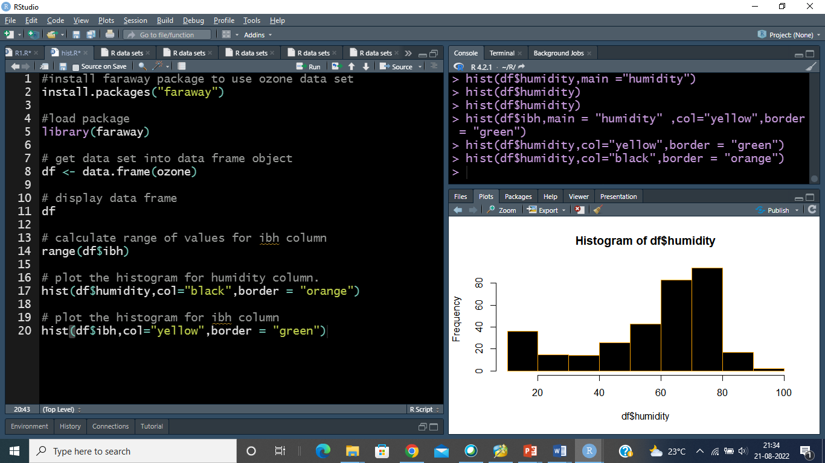

Slide 29
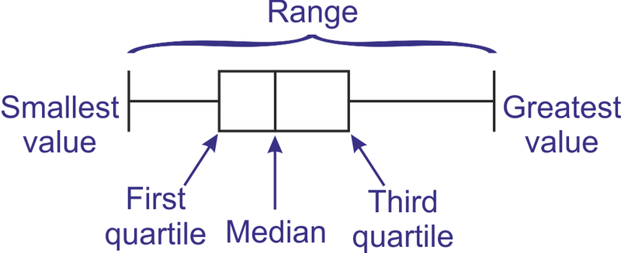
Univariate graphical EDA
Boxplots
Boxplots are a popular way of visualizing a distribution.
the ends of the box are at the quartiles so that the box length is the interquartile range.
The median is marked by a line within the box.
Two lines (called whiskers) outside the box extend to the smallest (Minimum) and largest (Maximum) observations.
Boxplots are excellent EDA plots because they rely on robust statistics like median and IQR rather than more sensitive ones such as mean and standard deviation.

Slide 30
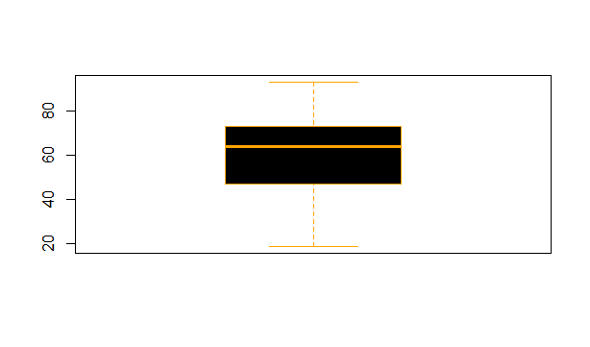
Boxplot for variable humidity
# R script to plot box plot for a given variable
boxplot(df$humidity,col="black",border = "orange")

Slide 31
Multivariate Analysis
The purpose of Multivariate Analysis is to show the relationship between two or more variables
Multivariate non-graphical EDA
Cross-tabulation for categorical data
Correlation and covariance matrix (for quantitative)
Multivariate graphical EDA
scatter plot
Heat Map

Slide 32
Multivariate non-graphical EDA
Multivariate non-graphical EDA techniques generally show the relationship between two or more variables in the form of either cross-tabulation or statistics.
Cross-tabulation
For categorical data (and quantitative data with only a few different values) an
extension of tabulation called cross-tabulation is very useful.
Cross-tabulation is the basic bivariate non-graphical EDA technique.
For two variables, cross-tabulation is performed by making a two-way table with column headings that match the levels of one variable and row headings that match the levels of the other variable, then filling in the counts of all subjects that share a pair of levels.

Slide 33
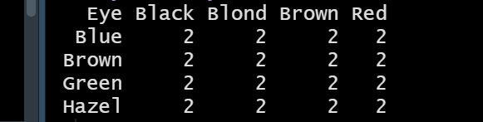
Cross-tabulation bivariate non-graphical EDA technique
Prepare cross-tabulation for Hair and Eye Column
# R code to create a cross-tabulation for Hair and Eye Column
#cross tabulation
df <-read_csv("HairEyeColor.csv")
df
tabyl(df, Eye, Hair)
#output

Slide 34
2. Correlation matrices
Correlation measures the relationship between two variables.
The correlation between two random variables is a number that runs
from -1 through 0 to +1 and indicates a strong inverse relationship,
no relationship, and a strong direct relationship, respectively.

Slide 36
Correlation matrix multivariate non-graphical EDA technique

Slide 37
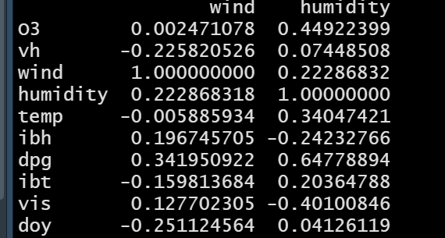
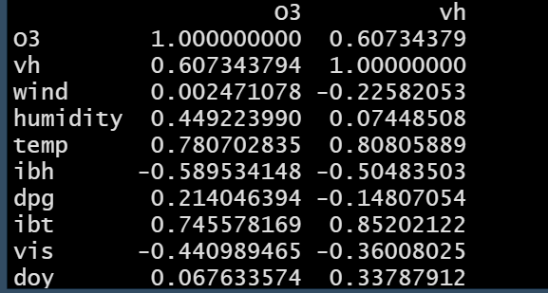
Prepare correlation matrix for ozone data set
# R code to generate correlation matrix
df <- data.frame(ozone)
df
df.cor=cor(df)
Highly correlated
Inverse Correlation

Slide 38
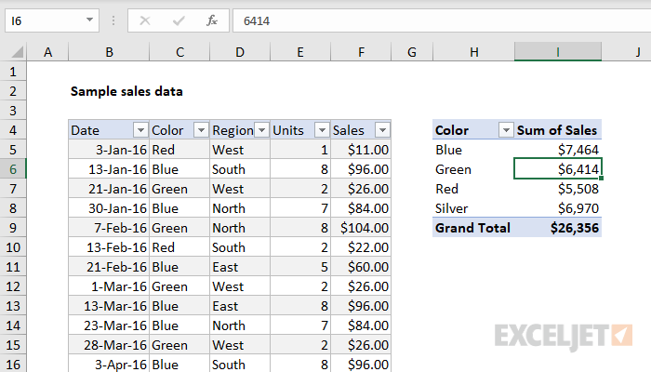
3. Pivot table
A PivotTable is a powerful tool to calculate, summarize, and analyze data that lets you see comparisons, patterns, and trends in your data.
Pivot table can created using Excel, R and python

Slide 39
Multivariate graphical EDA
Scatter Plot
Heat Map

Slide 40
Scatter Plot
For two quantitative variables, the basic graphical EDA technique is the scatterplot which has one variable on the x-axis, one on the y-axis and a point for each case in your dataset
If one variable is explanatory and the other is outcome, it is a very strong convention to put the outcome on the y (vertical) axis.
One or two additional categorical variables can be accommodated on the scatterplot by encoding the additional information in the symbol type and/or color.

Slide 41
Scatter plot and correlation
When the points in the graph are rising, moving from left to right, then the scatter plot shows a positive correlation.
When the points in the scatter graph fall while moving left to right, then it is called a negative correlation. It means the values of one variable are decreasing with respect to another.
When the points are scattered all over the graph and it is difficult to conclude whether the values are increasing or decreasing, then there is no correlation between the variables

Slide 42
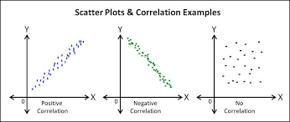

Slide 43
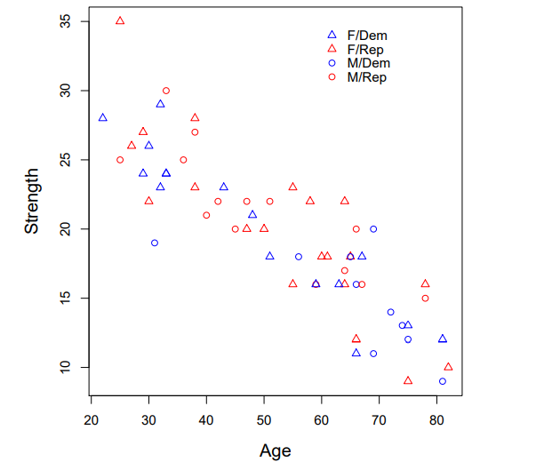
An example is shown in the figure Age vs. strength is shown, and different colors and symbols are used to code political party and gender.

Slide 44
2. Heat Map
Heat Map is a representation of data in the form of a map in which data values are represented as colours.
Because of their reliance on color to communicate values, Heat Maps are perhaps most commonly used to display a more generalized view of numeric values.
when dealing with large volumes of data, as colors are easier to distinguish and make sense of than raw numbers.
Heat Maps are innately self-explanatory . The darker the shade, the greater the quantity (the higher the value, the tighter the dispersion, etc.).
When existing data visualizations are paired with Heat Maps, their ability to rapidly communicate key data insights to the viewer is greatly enhanced.
Ex Correlation matrix when displayed using HeatMap it will allow to identify positive correlation, negative correlation and no correlation easily using various shades of colors

Slide 45
Prepare correlation matrix for ozone data set
# R code to generate correlation matrix
df <- data.frame(ozone)
df
df.cor=cor(df)
Highly correlated
Inverse Correlation

Slide 46
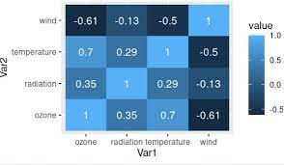
Correlation matrix using Heatmap

Slide 47
Revise
State need of EDA?
Explain the type of attributes with example respective type
Explain univariate graphical EDA techniques
Explain univariate non-graphical EDA techniques
Explain multivariate graphical EDA techniques
Explain multivariate non-graphical Eda techniques

